Slide 1

Student Performance Dashboard
Final Project – DEPI
Team Members
Mohamed Wael Mohamed (Team Leader)
Mohamed Atef Ibrahem
Seif Mohamed Helmy Ahmed
Nourhan Mohamed Ahmed

Slide 2
📋 Agenda
Project Overview
Objectives
Tools & Technologies
Data Analysis & SQL Queries
Visualization Dashboard
Data Modeling & Pipeline Architecture (DBT + DuckDB)
Conclusion & Takeaways

Slide 3
Project Overview
This project analyzes student performance data to identify academic patterns and key factors affecting student outcomes. By building a data-driven dashboard, the system helps educators monitor GPA trends, attendance behavior, and performance categories to support informed decision-making.
Using Python, SQL , Duckdb , DBT and visualization tools, we developed a clear and data-driven dashboard that supports early detection of at-risk students and enhances overall academic outcomes.

Slide 4

🎯 Project Objectives
The main objectives of this project are:
visualizations that make academic patterns easier to undTo preprocess and clean the student dataset by handling missing and duplicate values.
Understand key factors influencing student performance
Identify at-risk students using data insights
Provide administrators with a visual and interactive dashboard
Support academic improvement through measurable indicators
Build a scalable and modern data workflow for educational analytics

Slide 5



Tools & Technologies Used
The following tools and technologies were used throughout the project:
Python – Used for data preprocessing, analysis, and visualization. (Libraries: Pandas, Matplotlib, Seaborn, SQLite)
Duckdb : for Analytical Storage
DBT: for data Transformationa and Models
Jupyter Notebook – Used as the main environment for code development and testing.
PowerPoint – Used for documentation, visualization presentation, and reporting.

Slide 6
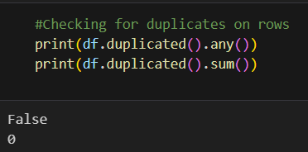
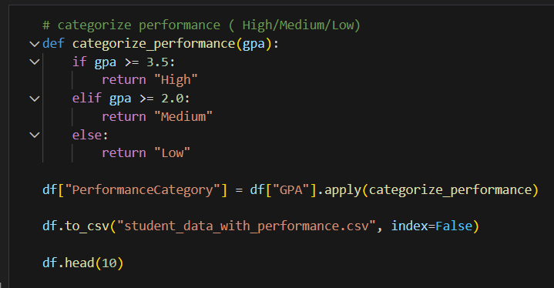
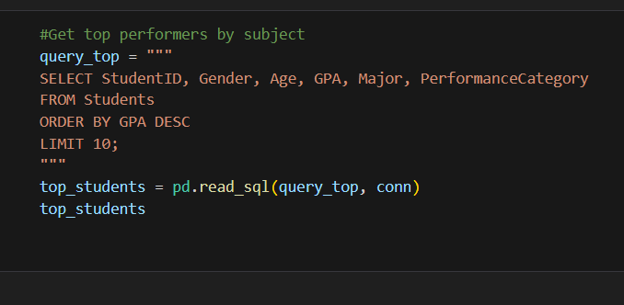
📊 Data Analysis & SQL Queries
During this stage, the dataset was cleaned and prepared for analysis by: • Removing missing and duplicate values. • Creating a new column called Performance Category to classify students based on GPA.
SQL queries were then used to extract key academic insights, such as: • Average GPA by Gender and Major. • Relationship between Attendance and GPA. • List of top-performing students.

Slide 7
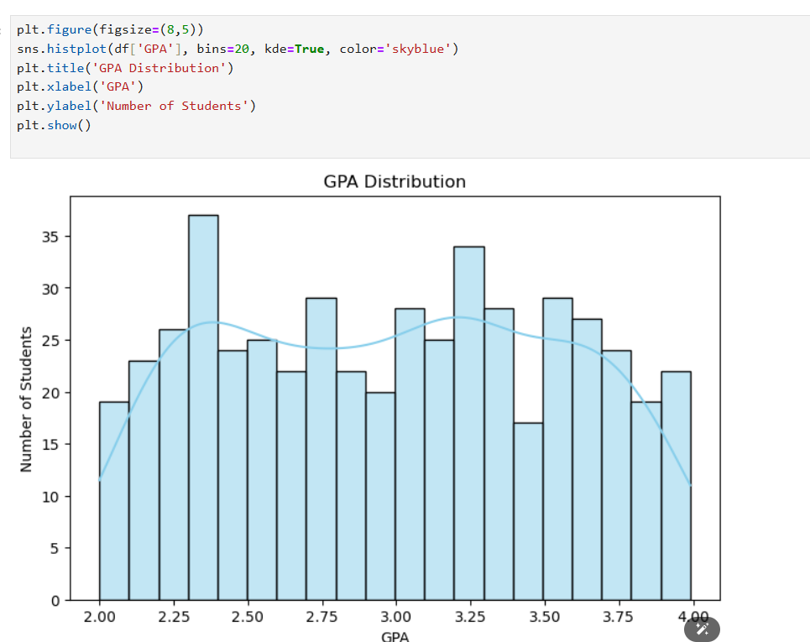
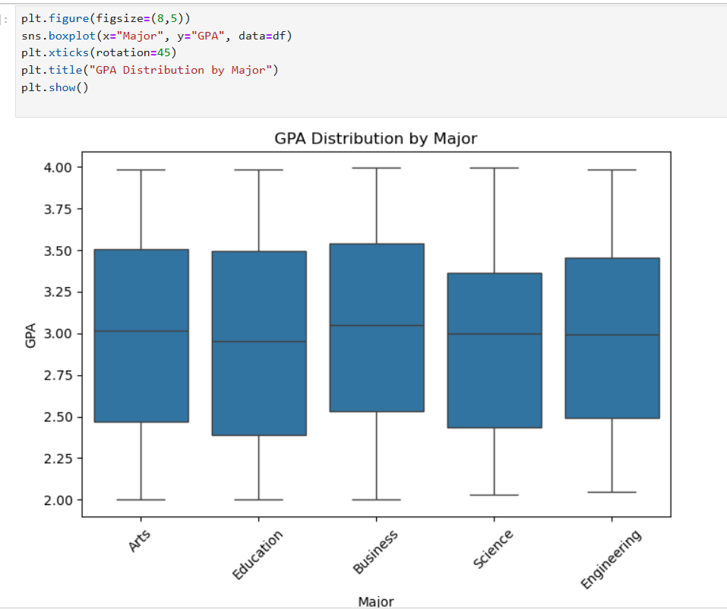
📈 Visualization Dashboard
The visualization dashboard was designed to present clear and interactive insights into student performance.
It includes several visual elements that highlight key academic patterns: • Bar Chart: Average GPA by Major. • Pie Chart: Distribution of performance categories (High, Medium, Low). • Scatter Plot: Relationship between Attendance and GPA.
These visualizations help identify trends and support data-driven decision-making in the education process.

Slide 8
Data Modeling & Pipeline Architecture (DBT + DuckDB)
We implemented a modern data engineering pipeline that transforms raw student data into analytical models:
Raw data is loaded into DuckDB
DBT applies transformations and creates a star schema
Fact Table: Student Performance
Dimensions: Student, Major, Performance Category, Attendance
The Streamlit dashboard connects directly to DuckDB for real-time analytics
Result: A scalable, fast, and industry-standard data architecture that elevates the project beyond a normal dashboard.

Slide 9
💡 Conclusion & Takeaways
Students with higher attendance achieved higher GPAs, proving attendance is a strong indicator of academic success.
Female students showed slightly higher GPA averages, reflecting subtle performance differences across gender.
The new analytical pipeline using DBT + DuckDB improved data consistency, performance, and reliability, transforming the dashboard into a professional data engineering solution.
The system supports early detection of struggling students, enabling proactive academic intervention.

Slide 10

🤝 Acknowledgment & References
We would like to express our sincere appreciation to our mentors and instructors at DEPI for their continuous support and guidance throughout this project.
References: • Python Libraries: Pandas, Matplotlib, Seaborn, SQLite. • Tools: Jupyter Notebook, Duckdb, DBT, PowerPoint. • Dataset: Student Performance Dataset (prepared for DEPI project).
This project was completed as part of the DEPI Final Milestone submission, October 2025.

Slide 11
THANK YOU

